Slide 1
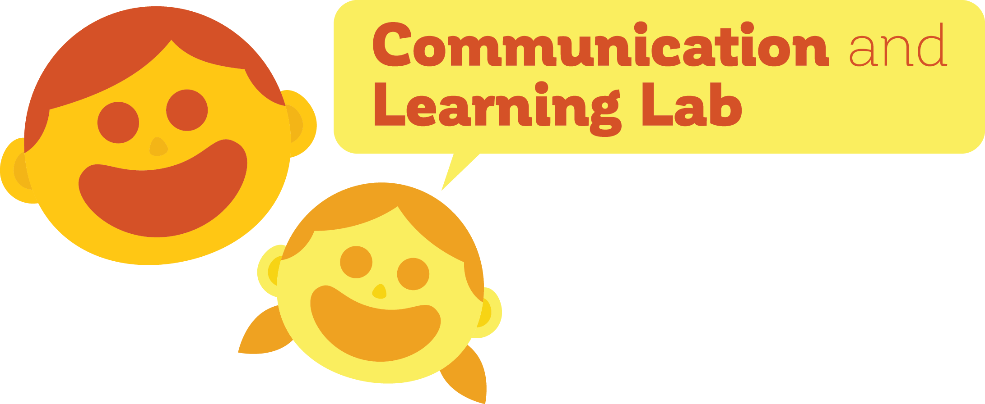
Interlocutors preserve complexity in language
Madeline Meyers
PI: Dan Yurovsky, Ph.D.
University of Chicago

Slide 2
Why do languages evolve?
Languages need to be effective for communication
Languages need to be easily learnable by new speakers

Slide 3

Using iterated learning to study evolution
Randomly-generated language
Generation 1
Generation 2
Resultant language
Generation 3
Kirby et al. (2008)
Notes:
How do we study the effects of these pressures on language in the lab??

Slide 4
Using iterated learning to study evolution
Randomly-generated language
Generation 1
Generation 2
Resultant language
Generation 3
Notes:
How do we study the effects of these pressures on language in the lab??

Slide 5
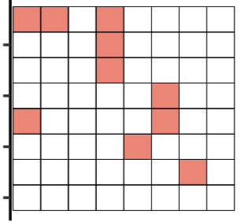
Experiment 1 paradigm
Kempe et al. (2015)
Notes:
Introduce dot patterns earlier

Slide 6
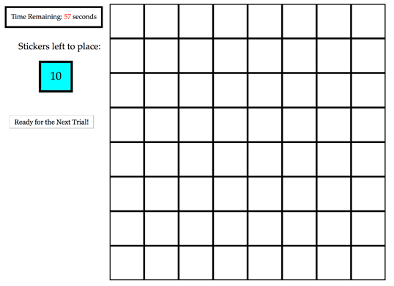
Experiment 1 paradigm

Slide 7
Accuracy increases over generations

Slide 8
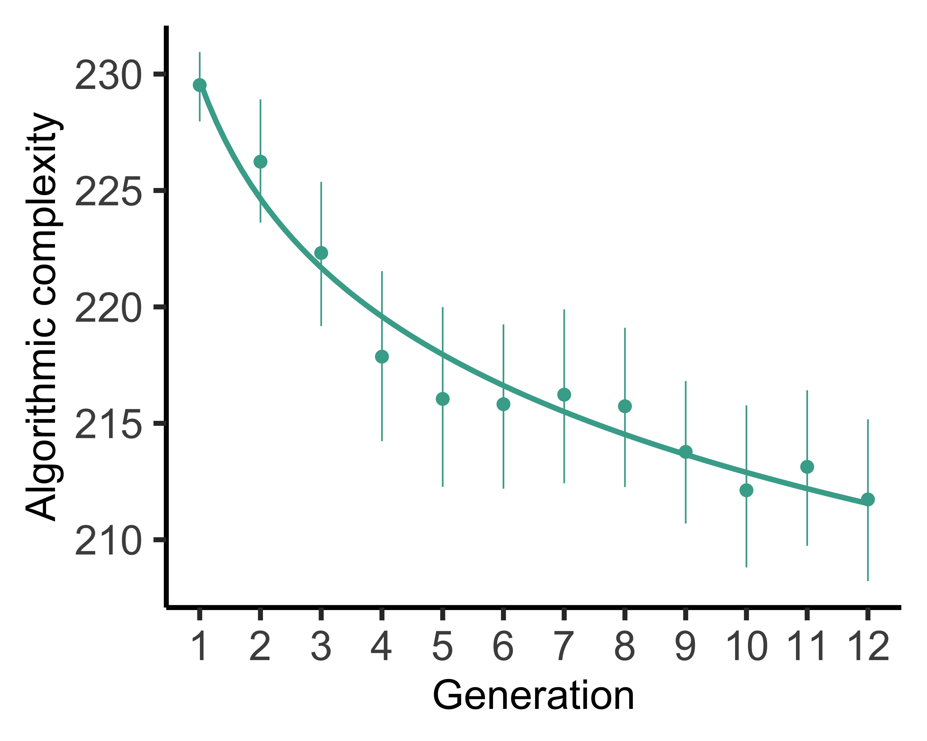
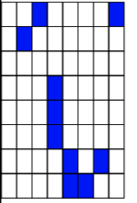
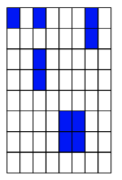
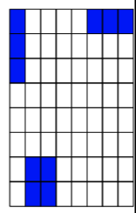
Complexity decreases over generations
Notes:
Put grids directly on this plot
Directly replicates Kempe findings

Slide 9
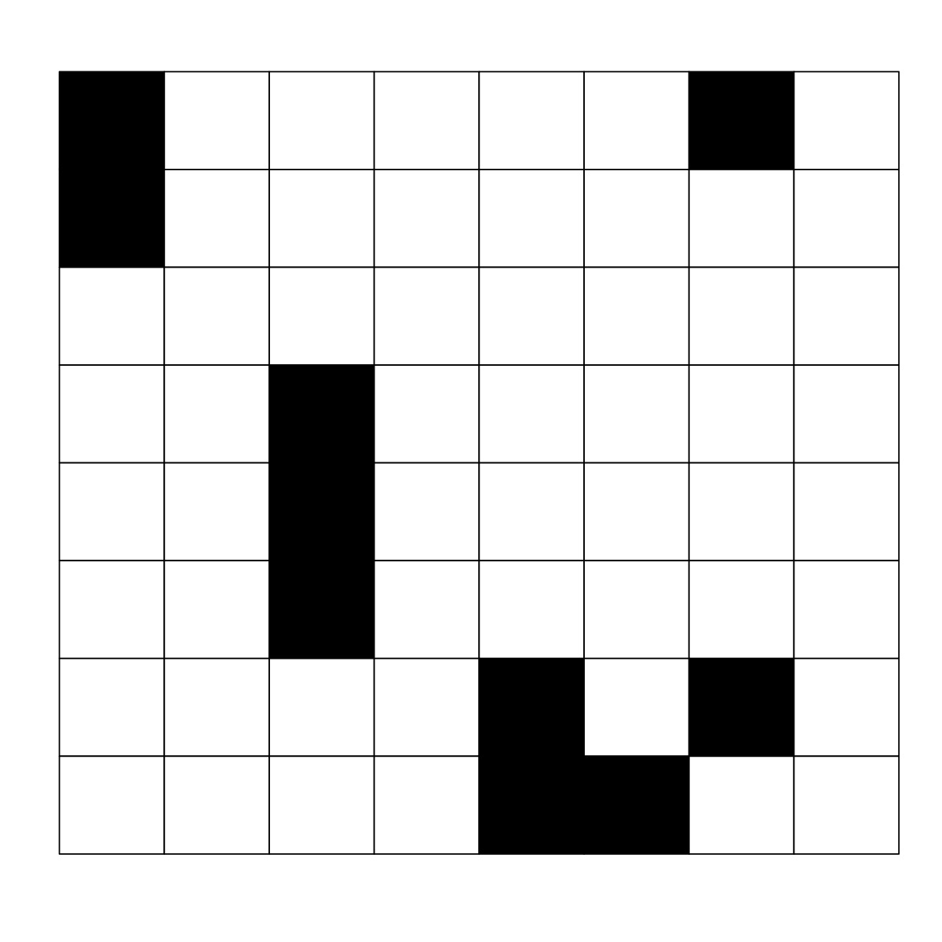
Experiment 3 paradigm
1 ) Learner

Slide 10
Experiment 3 paradigm
1 ) Learner
“your job is to re-create patterns to match a target”

Slide 11
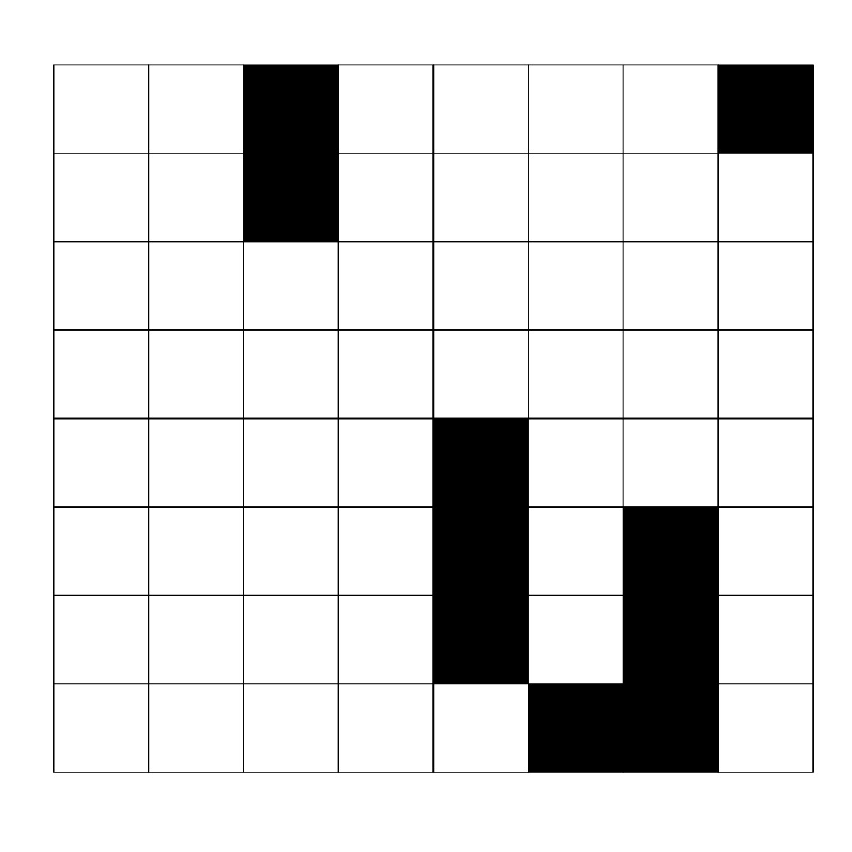
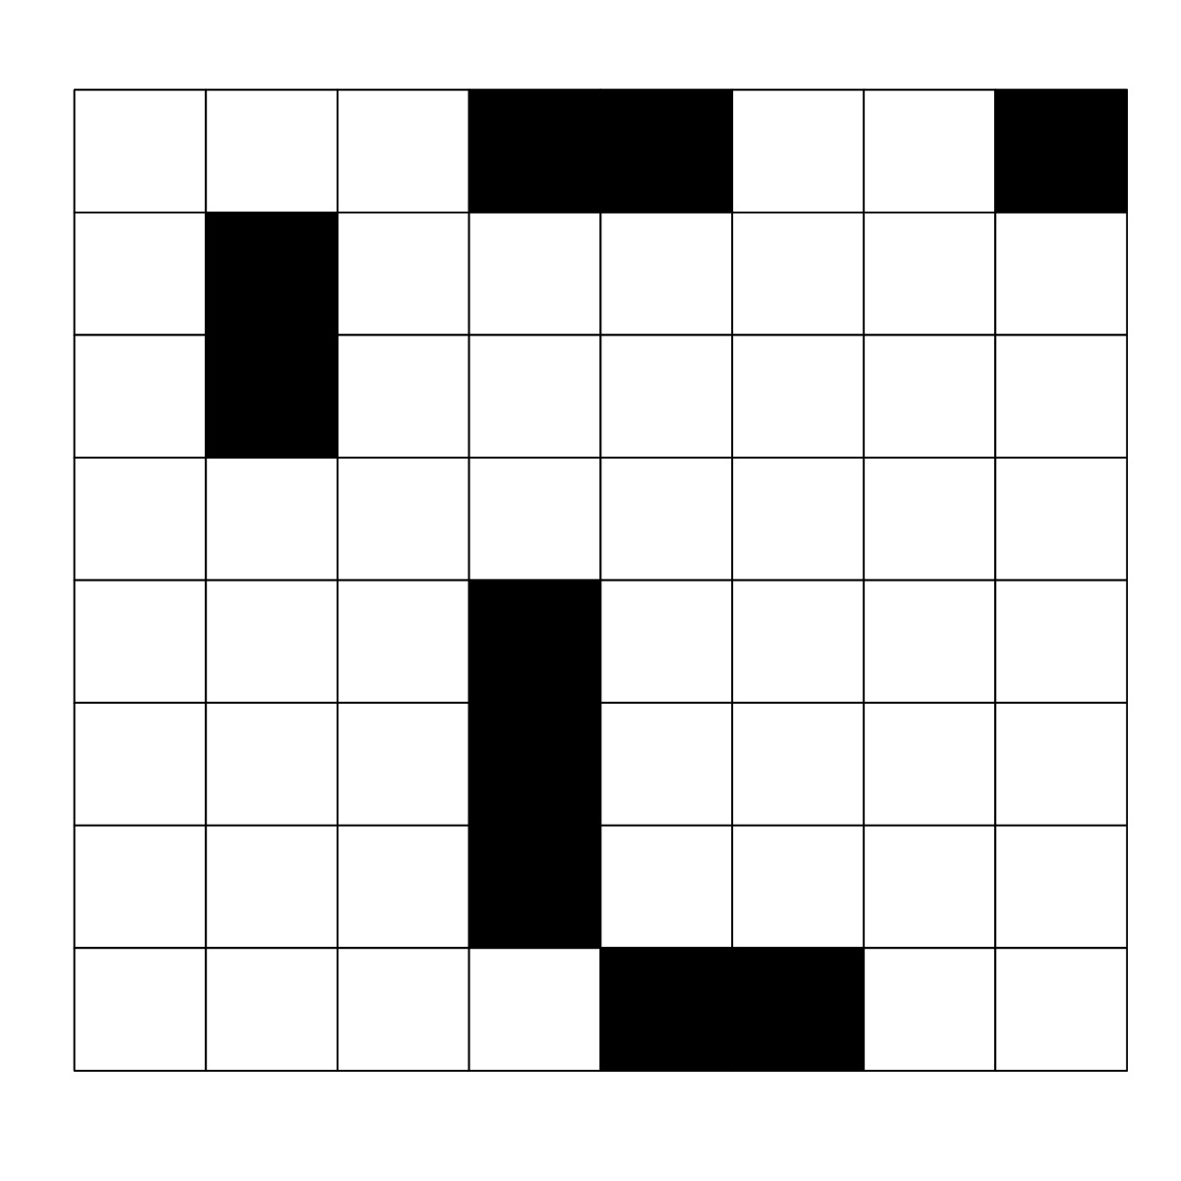
Experiment 3 paradigm
1 ) Learner

Slide 12
Experiment 3 paradigm
2) Fixer

Slide 13
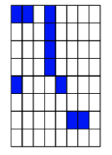
Experiment 3 paradigm
2) Fixer
“your job is to correct errors on the grid patterns to match the target”
Notes:
Explain more how this is an easier task [change-detection versus spontaneous generation task]

Slide 14
Experiment 3 paradigm
2) Fixer

Slide 15
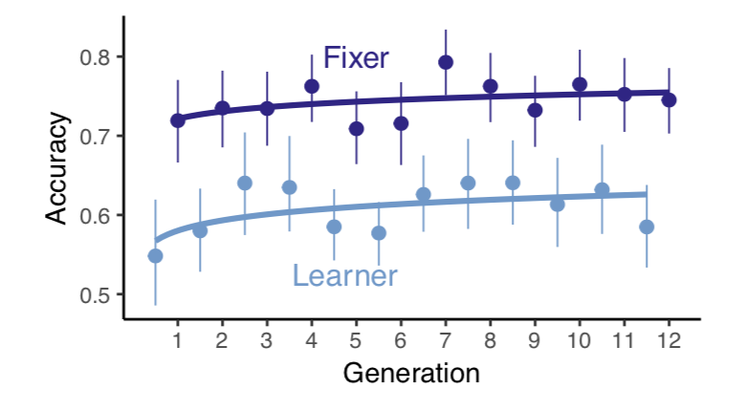
DYAD achieves consistent levels of accuracy
Notes:
Make sure that justification for fixer-parent

Slide 16
While Editors Reintroduce complexity
Notes:
Learner is not red change color ; fix axes ; think about how to talk about passing on fixer’s language
-add in seesaw lines

Slide 17
Editors help retain a higher level of complexity
Notes:
Feedback on how to describe the fixer passing on language
-put in broken line for y-axis scale

Slide 18
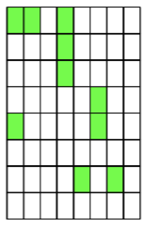
Preliminary conclusions
Complexity is lost in transmission
This complexity is not lost forever
The presence of an editor helps retain more complexity than an individual learner alone
Stability was higher & was reached faster
Languages change in response to their learners and speakers
Our biases matter
Our conversational partners matter
Notes:
-bring in more learnability/communicability (or skip maybe?)

Slide 19
Qualitative Analyses
Are the types of errors that parents and children are making similar or different?
Code 17 chains (so far) for error types
10 adults (baseline), 7 children (baseline)
Notes:
-bring in more learnability/communicability (or skip maybe?)

Slide 20
Coding scheme
Geometric Errors
Translation
Rotation
Mirroring
Other Errors
No Relation
Chunking/Un-Chunking
Diagonal Chunking
Edges & Corners
Shape Change
Symmetry
Iconicity
Notes:
-bring in more learnability/communicability (or skip maybe?)

Slide 21
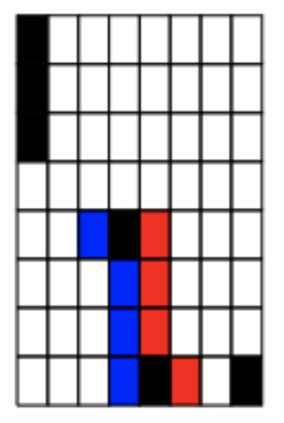
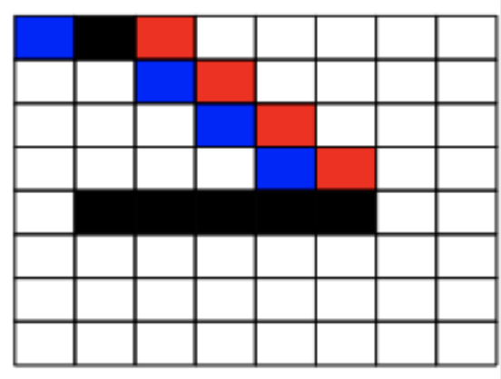
Translation
Notes:
-bring in more learnability/communicability (or skip maybe?)

Slide 22
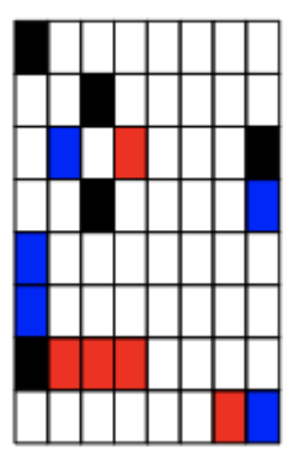
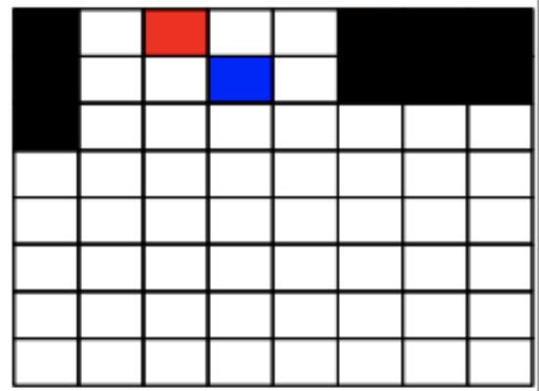
rotation
Notes:
-bring in more learnability/communicability (or skip maybe?)

Slide 23
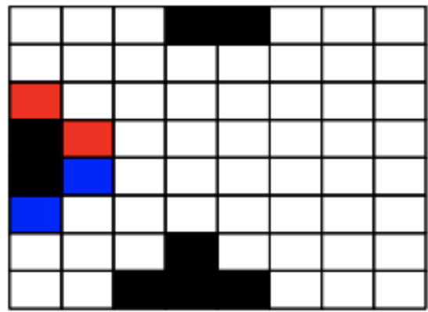
mirroring
Notes:
-bring in more learnability/communicability (or skip maybe?)

Slide 24
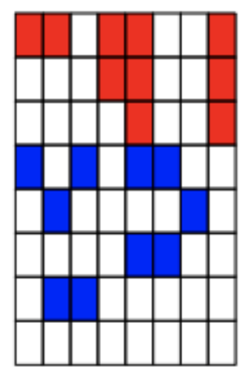
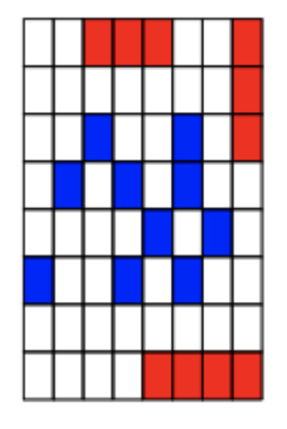
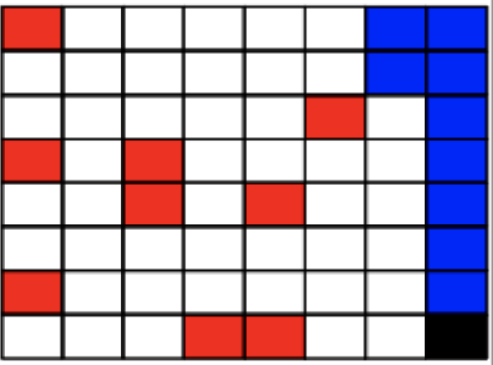
No relation
Notes:
-bring in more learnability/communicability (or skip maybe?)

Slide 25
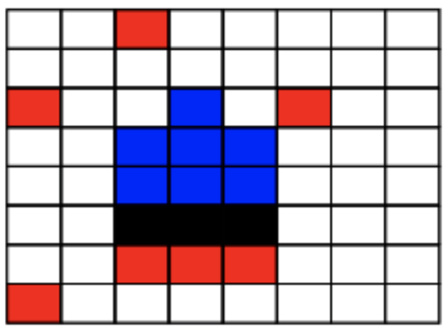
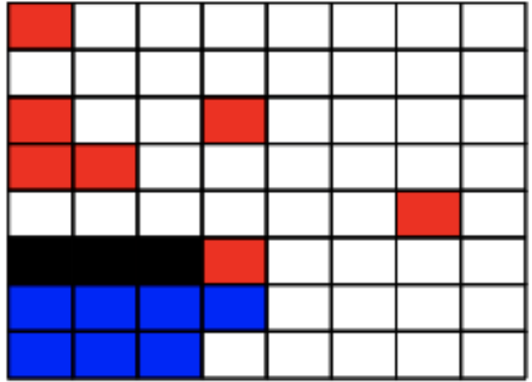
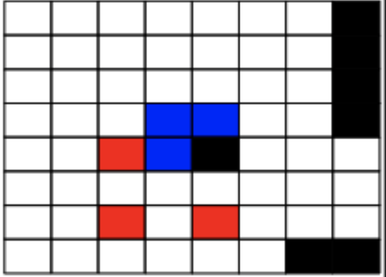
chunking
Notes:
-bring in more learnability/communicability (or skip maybe?)

Slide 26
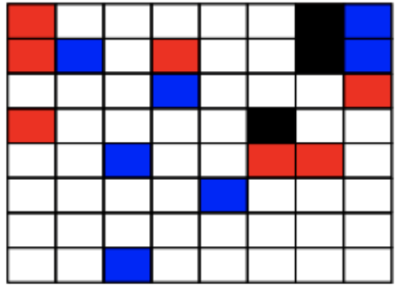
Un-chunking
Notes:
-bring in more learnability/communicability (or skip maybe?)

Slide 27
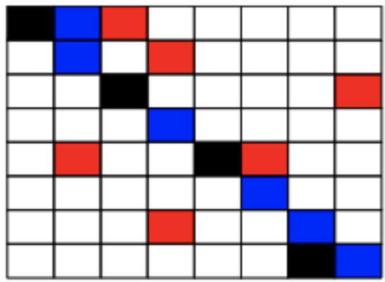
Diagonal chunking
Notes:
-bring in more learnability/communicability (or skip maybe?)

Slide 28
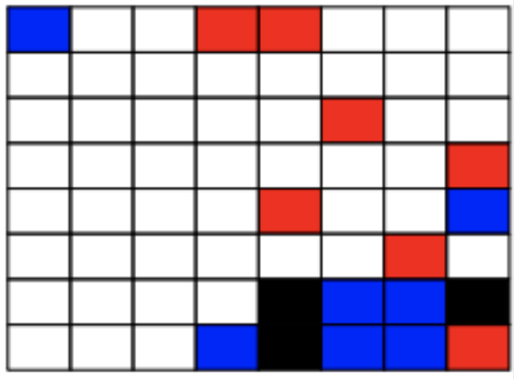
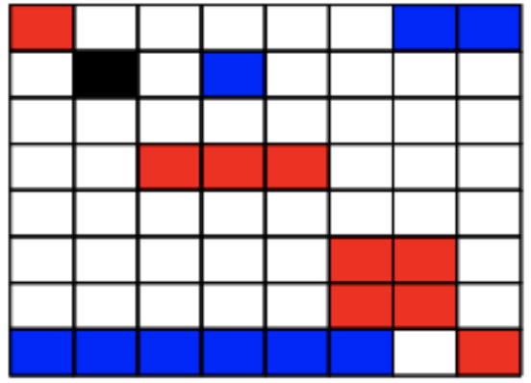
Edges & corners
Notes:
-bring in more learnability/communicability (or skip maybe?)

Slide 29
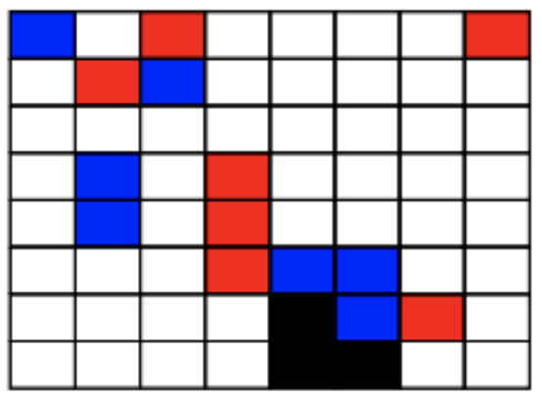
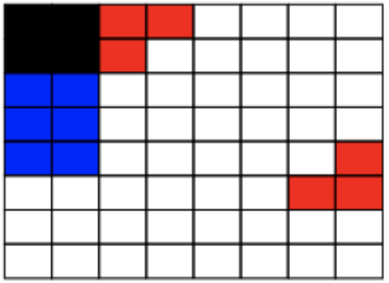
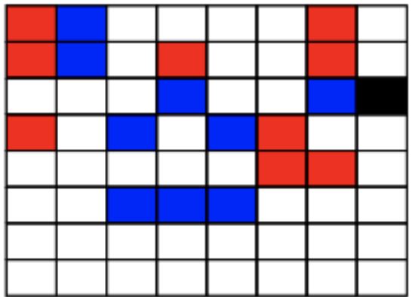
Shape change
Notes:
-bring in more learnability/communicability (or skip maybe?)

Slide 30
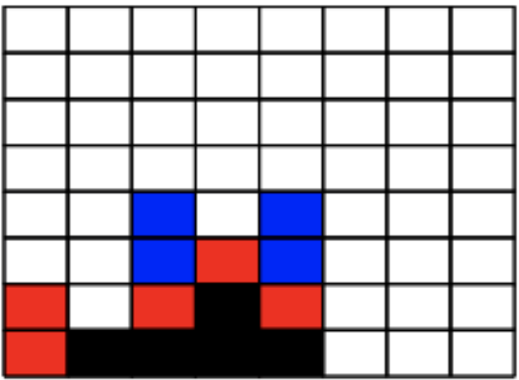
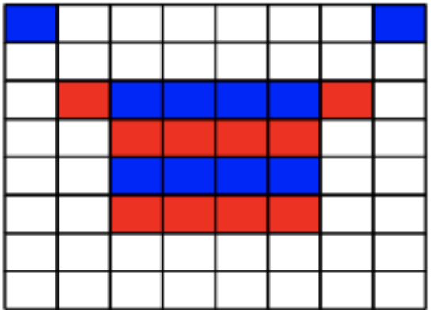
symmetry
Notes:
-bring in more learnability/communicability (or skip maybe?)

Slide 31
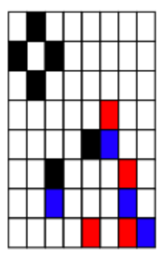
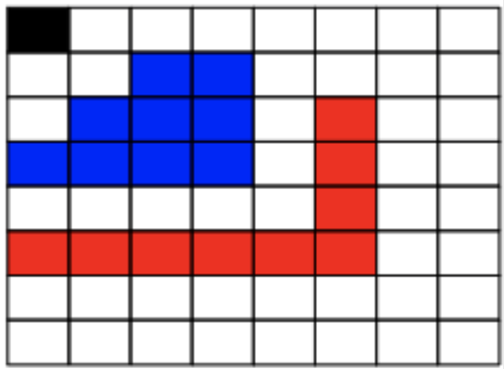
”iconicity”
Notes:
-bring in more learnability/communicability (or skip maybe?)

Slide 32
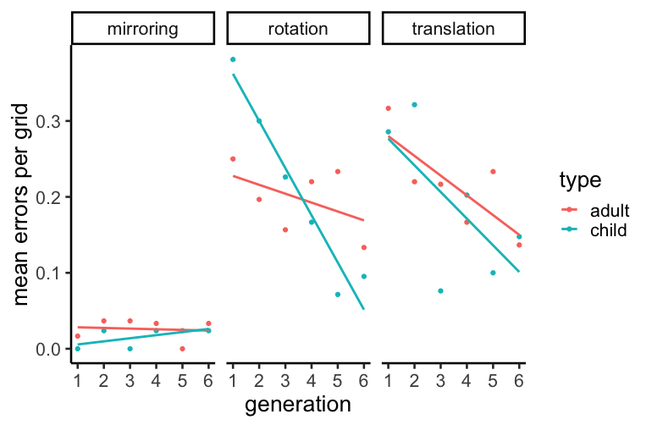
Qualitative results- Geometric errors
Notes:
-bring in more learnability/communicability (or skip maybe?)

Slide 33
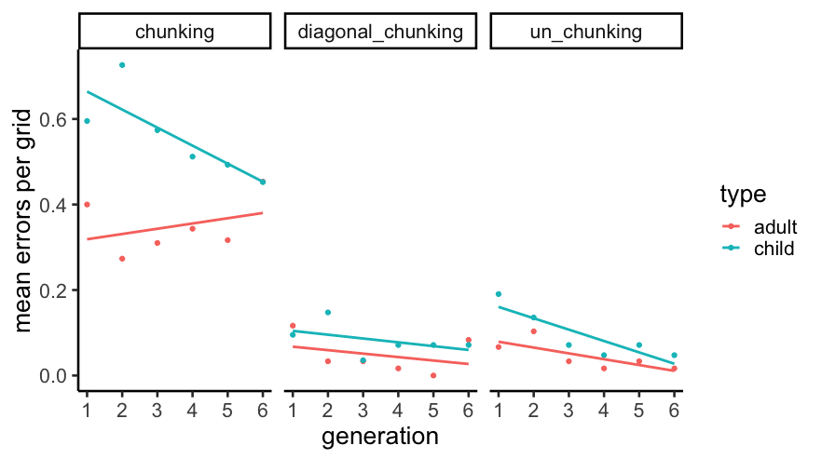
Qualitative results- chunking
Notes:
-bring in more learnability/communicability (or skip maybe?)

Slide 34
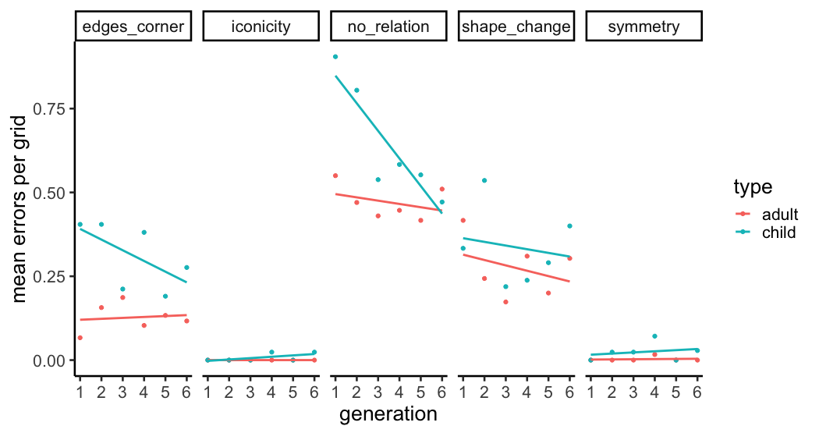
Qualitative results- other errors
Notes:
-bring in more learnability/communicability (or skip maybe?)

Slide 35
Questions
How to interpret these findings?
Is there anything we missed in the coding scheme?
Coding the dyad task (for “fixed” errors)
Notes:
-bring in more learnability/communicability (or skip maybe?)

Slide 36
Structure task
What is ”structure” in a language? How do you quantify it?
Structure as within a pattern vs. across a set of patterns
Are languages becoming more structured over generations?
Notes:
-bring in more learnability/communicability (or skip maybe?)

Slide 37
Structure task
Generation
Chain
Display
Each participant completes 6 trials, 1 display = 1 trial
Gen 1
Gen 2
Gen 3
Gen 4
Gen 5
Gen 6
Chain 1
Chain 2
Chain 3
Gens 1-6
Gens 1-6
Gens 1-6
Notes:
-bring in more learnability/communicability (or skip maybe?)

Slide 38
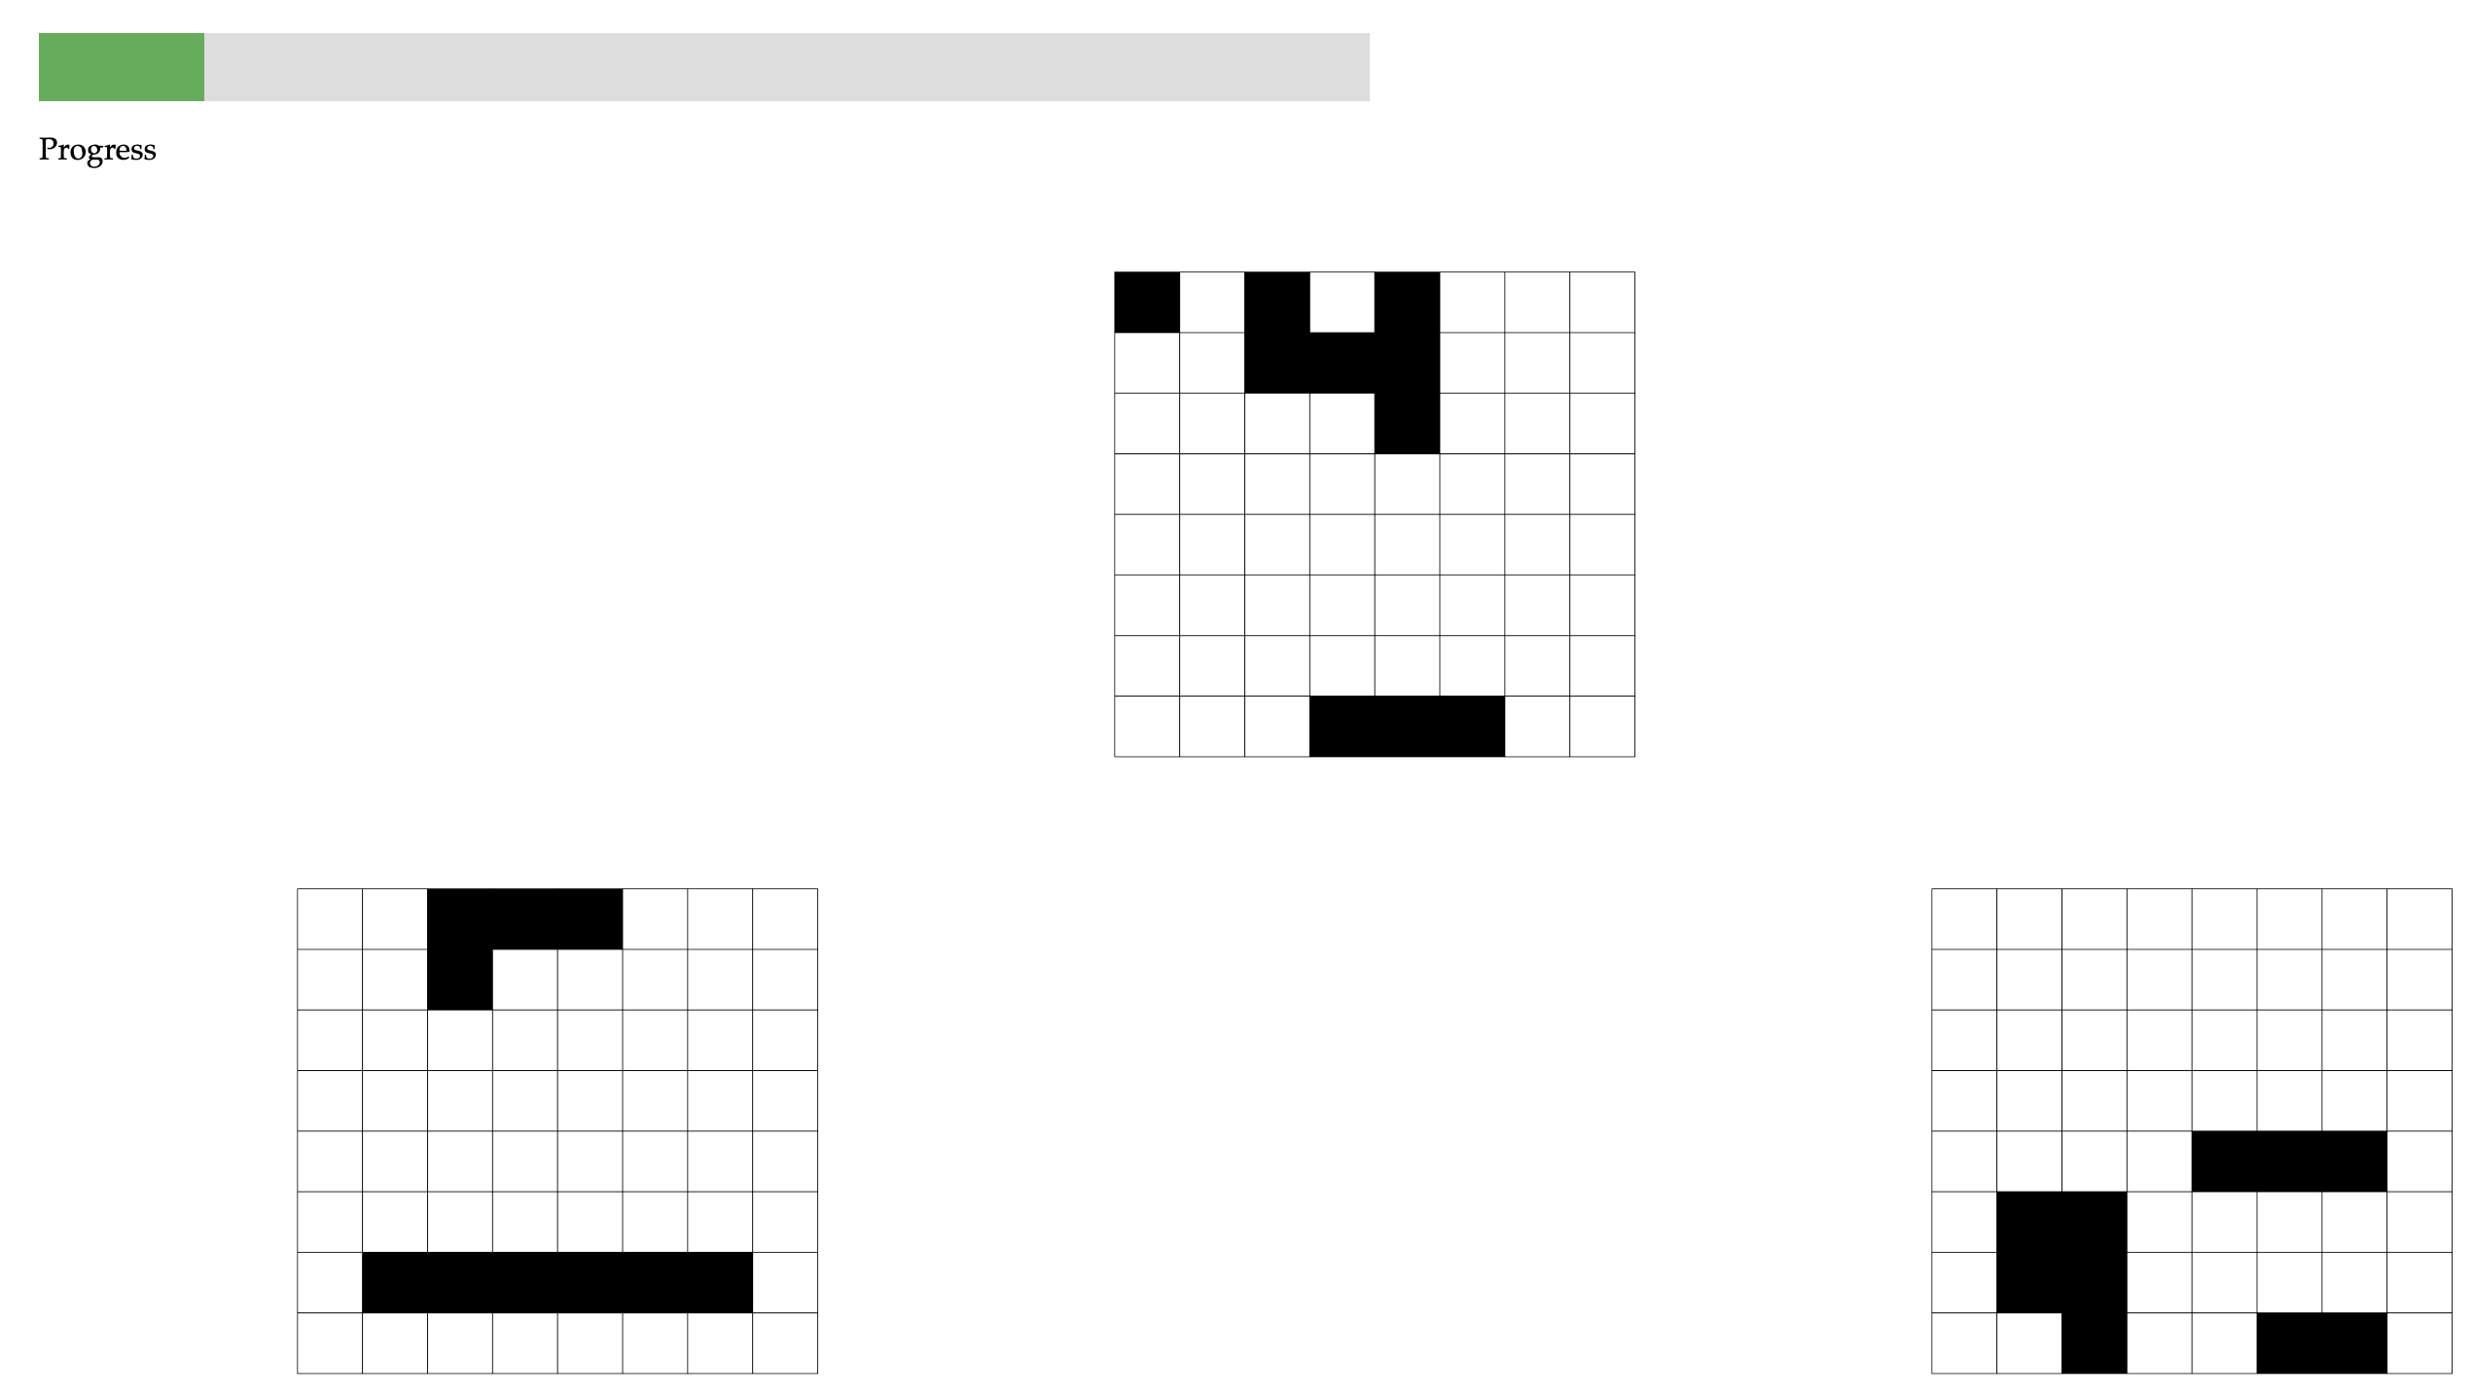
Structure task
Chain 1, Gen 6, Display 3
Chain 1, Gen 6, Display 4
Chain 2, Gen 6, Display 4
Notes:
-bring in more learnability/communicability (or skip maybe?)

Slide 39
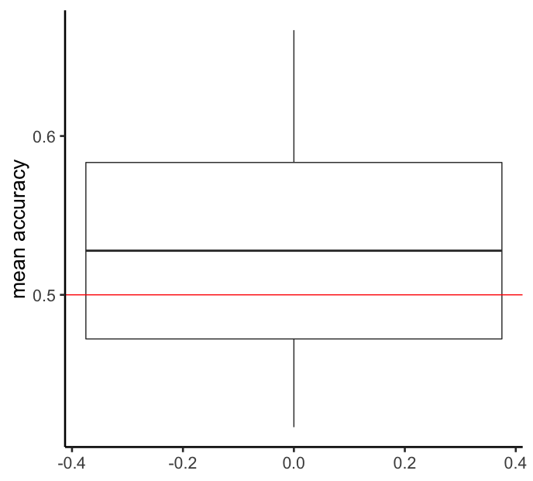
Structure results
N=20 adults on mTurk
40 trials each
Filtering by accuracy on attention checks did not alter results
Notes:
What do these results tell us?
Is it worth trying to see generational effects or kid vs adult effects?

Slide 40
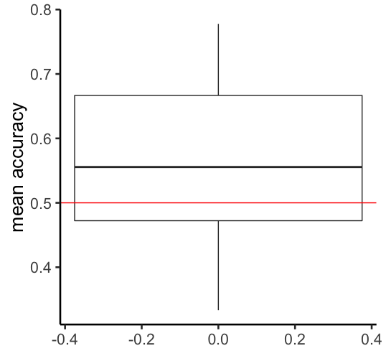
Structure results-first 10 trials only
Notes:
What do these results tell us?
Is it worth trying to see generational effects or kid vs adult effects?

Slide 41

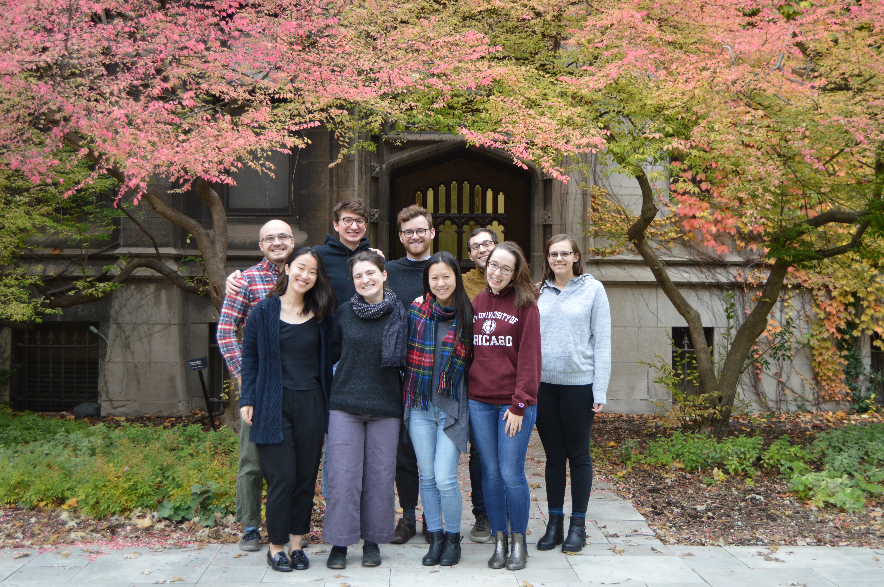


Thank you!

Slide 42
Experiment 2: Replication/extension of experiment 1
480 adults on Amazon Mechanical Turk
40 separate chains of 12 generations
Measured
Percent Accuracy
Complexity

Slide 43
Experiment 3: ADULT-ADULT DYAD
960 adults on Amazon Mechanical Turk
480 Learners, 480 Fixers
40 separate chains of 12 generations

Slide 44
Algorithmic complexity measure
“fill in two cells diagonal in the top, one on the right hand corner, three that are third from the left, make an angular shape and add a diagonal.”
“fill in every other cell”
Zenil et al. (2015)
Notes:
Keep examples but maybe take out text; simpler measures of complexity and compare to other things

